Slide 1
Clinker Cooler Air Distribution TASK
SPREAD course 2016 - 2017

Slide 2
Air Distribution Clinker Cooler
Cooling air measurements have been made
Using the Cooler Assessment Tool, evaluate the data and assess the clinker cooler operation
Use the “Guidelines and hints” tab
What are your main findings?
For each finding, what is the possible effect on operation?
What are your recommendations?
Assess the cooling air distribution. How can you improve?

Slide 3
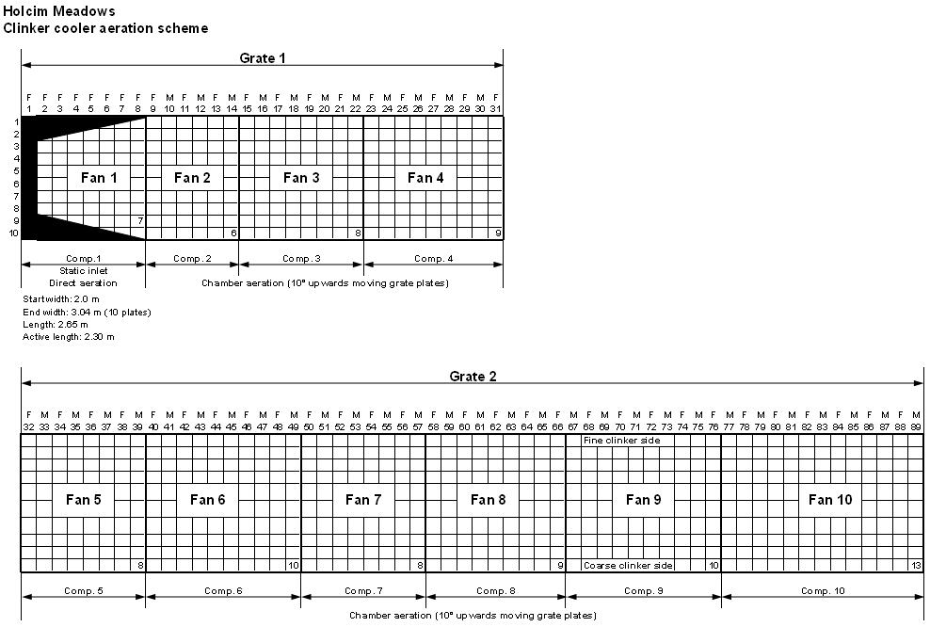
Cooler Aeration Scheme

Slide 4
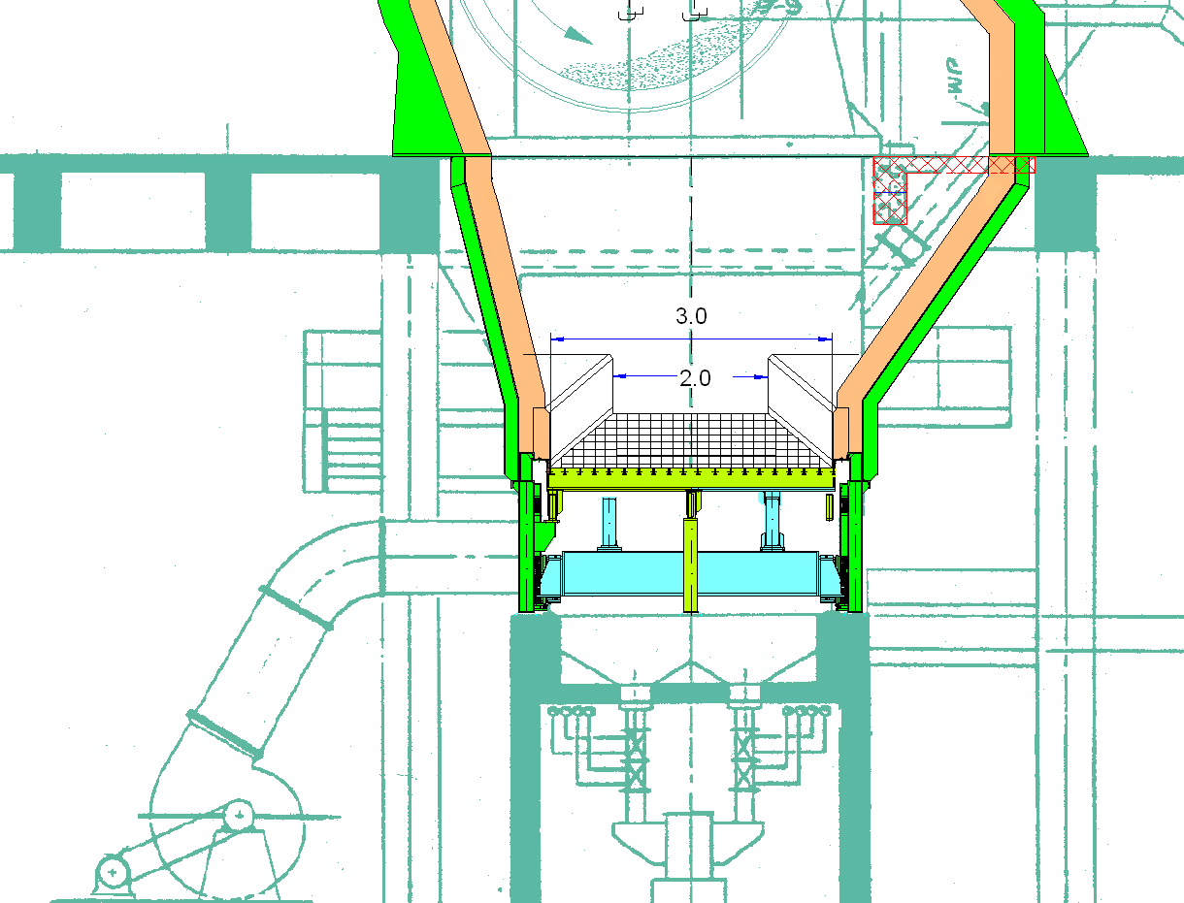
Cooler static inlet with horseshoe

Slide 5
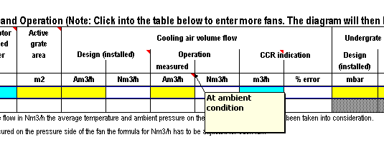
A Closer Look - Clinker Cooler Air Distribution
All measured data should be converted to ambient conditions at the fan inlet side

Slide 6
Specific Task
The flow of fan 7 has been measured in the duct between the fan and cooler side wall: 31’339 Am3/h at 32°C
Convert this air flow to ambient conditions at the fan inlet

